Slide 2
Web Services?

Slide 3
Agenda
  Motivation
  Brief Introduction to Web Service Technologies
  Web Services with PHP5
  Core Components of InstantSVC
    Extended Reflection API and Annotations for PHP
    WSDL Generator and Adapter Generator
    SOAP Handler Chains and WS-Security for PHP5
    RESTful Web Services
  Administration Front-End
  Live Demo

Slide 4
Services?
  Blog with Web 2.0 stuff
    Feeds, Publishing API, User Contribution, Single-Sign On,…
  Shops
    Catalog of Goods, Buying API, Availability Checks
    Intention: Close the Media Gap
  Enterprise Applications
    Finance, Warehouse Management, Human Resources,…
  Services provided by specialists
    Used to build applications upon
Notes:
The term service refers not only to offers of computing based solutions. It includes all real world services you could think of. Hear cutting, craftsmen work, delivery of goods or manufacturing a car at customer's option.
Now, have a look at Web Services. They are the technical basement to offer those services to the world and provide a standardized way to allow customers to integrate the offered real world services into their business and make use of them.
You have heard of the fridge ordering coke or convenience foods on own behalf. If the thermometer is showing constantly to high temperatures it could send a repair order to a craftsman, too. That is possible, because you are providing a Web Service offering an interface which can be used to automate this order processing.
Sounds to spacy? Ok, let’s stick to more convincing examples.
Blogs are everywhere. What web services do they offer or use? You did like to stay in-touch with your friends or colleagues, just subscribe to their feeds with your favored feed reader. Most blogs offer interfaces to publish content with word-processing tools. User comments are posted via AJAX using a REST web service, too. Combined with a nice Single-Sign On solution, blogs can ask another web service, whether you are allowed to post your comments, without forcing you to enter your password at each blog again and again.
There may be no need to automate things beside the login, but if you’re looking at a simple web shop, you could start to compare prices and offers or let your fridge do so automatically. Just provide access to the catalog of your goods in a structured way and expose an interface to send you orders. After your shop system has done availability and validity checks it could forward this order to your shipping partner.
Eventually, enterprise applications will offer there services as web services to be integrated into a steady changing IT infrastructure to keep pace with changing business requirements. Furthermore, they will consume external services to reduce costs. Services from companies like yours; specialists in their field.

Slide 5
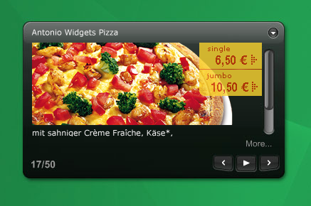
Services: For Whom?
Enterprise People
Innovators
  Portals and Mesh-Ups
    Personalization
    Single-Point-Of-Access
    Tools for there employees
  Composite Applications
    Workflows for their customers
    Quick and cheap, but with convincing quality
  It is cool
  Everybody wanne have it
  Is it Flickr, del.icio.us, Digg, Google Maps, Ebay?
  Likely, it’s not!
  You did not imagine what's possible with your services
  They do!
Notes:
Who did like to build Apps based on your services?
You don’t imagine, but you’ll make them pay for your services, so you’ll earn money and get something to eat.
You’re not convinced and ask for whom you should provide your services as web services?
There will be two major stereotypes of possible users. Enterprise People and so called Innovators, may be even Inventors.
ENTERPRISE PEOPLE
As already outlined, enterprises will offer and consume services. With the internet and cheap communications and logistics we got globalization. Today, almost everybody can buy and sell goods or services allover the world. Thus, enterprise will choose the provider of goods and services by criteria like price and quality, not any longer predominantly by neighborhood.
And they do this using web services, because they need to reduce their personal costs and automate things where possible.
Large companies and software vendors like SAP encourage there employees to use Portals and Mesh-Ups to increase their productivity. This is because here the knowledge workers get a personalized workbench, as a Single-Point-Of-Access to their daily work. These portals are so called composite applications. Using web services to provide the functionality the user needs. Here they can change and enhance workflows and tools without the need of change the stable and reliable enterprise software it is build upon. This reduces costs and can reduce the time-to-benefit.
Here the idea is to build small parts of functionality inside of portals or rich client applications with out touching the enterprise infrastructure itself. The small parts can use what ever web service they need to offer the needed functionality as higher level service to the user.
INNOVATORS
But what did Innovators do? Don’t know exactly.
They do the cool stuff. Something everybody would like to have.
May be your thinking in terms of Google, Google Earth, Flickr, Ebay or iPhone.
Ok, it has not to be new, but convincing. Probably they will do something you could not even think off, or they do it a way you never have had in mind. But the good news is. They need you. Your services. No iPhone without AT&T, no Flickr without its users. No shop without its customers.
OPEN YOUR SERVICES TO THE PUBLIC!
May be you still can’t imagine who is willing to pay you for your services, ordering it using web services.
But yesterday we ordered our pizza via phone or may be at an internet page. Tomorrow, at lunch time, my “Vista Side-Bar” is offering Pizza, Frosta-Food and this nice Chicken Special from the Indian around the corner. I can choose what ever I like and it’s delivered within hopefully 30 minutes.
The day after, it’s offering other dishes automatically, may be using Google and Google Map to estimate whether they could deliver in time. Even if you don’t know how it could be used, if there is anything that could be used, provide it as web services, your creative customers will be grateful.

Slide 6
Web Services
  Functions of an application
  exposed as services
  Technologies:
    HTTP
    SOAP
    WSDL
    UDDI
  Alternative:
    REST
  Powerful concept for cross-platform integration
Notes:
B2B Integration
Buzzword: SOA
Client Anbindung
Bsp.: EBay, Amazon E-Commerce
Google Suche
Aber auch zur Bereitstellung von z.B. Content, Premium Content an Partner
Hier Einsatzgebiet Lehrveranstaltungen/Vorlesungen/Konferenzvorträge mit z.B. Videoaufzeichnungen
Nutzung durch Partner für Lehrveranstaltungen z.B. in China
Beschreibung über Web Service Description Language

Slide 7
The Core Web Services
Protocol Stack
Discovery
UDDI
(Itself a Web Service)
Description
WSDL, WSFL/XLANG,
others to come
Access
SOAP, SOAP with Attachments, XML-RPC, REST
Transfer
HTTP, SMTP, FTP, others
Transport
TCP/IP, UDP, others

Slide 8
SOAP – The Messaging Protocol
<?xml version="1.0" ?>
<Envelope>
<Header>
…
</Header>
<Body>
…
</Body>
</Envelope>

Slide 9
Web Services Description Language (WSDL)
<definitions>
  <types />
  <message />
  <portType>
  <operation />
  </portType>
  <binding />
  <service>
  <port />
  </service>
</definitions>
  Container for data type definitions using some type system (such as XML Schema)
  Abstract, typed definition of the data being communicated
  Abstract set of operations
  Abstract description of an action supported by the service
  Concrete protocol and data format specification for a particular port type
  Collection of related endpoints
  Single endpoint defined as a combination of a binding and a network address
source: W3C

Slide 10
Web Services with PHP5
Steps for creating Web Services using the SOAP extension of PHP5:
  Create XMLSchema for data types
  Write WSDL service description
  Own wrapping for Document/Literal
  Include documentation
  Build SOAP server script
  No support for additional WS-* standards (e.g. WS-Security)

Slide 11
The Vision
  Consuming Web Services already supported by tools
  Providing Web Services is still to much work
  On other platforms like Java EE or .NET:
    Extensive tool support
    Annotations
    Deployment to Application Servers
  Vision:
    Generation of Web Services for existing applications
    Configuration instead of programming
    Complete automation of the process

Slide 12

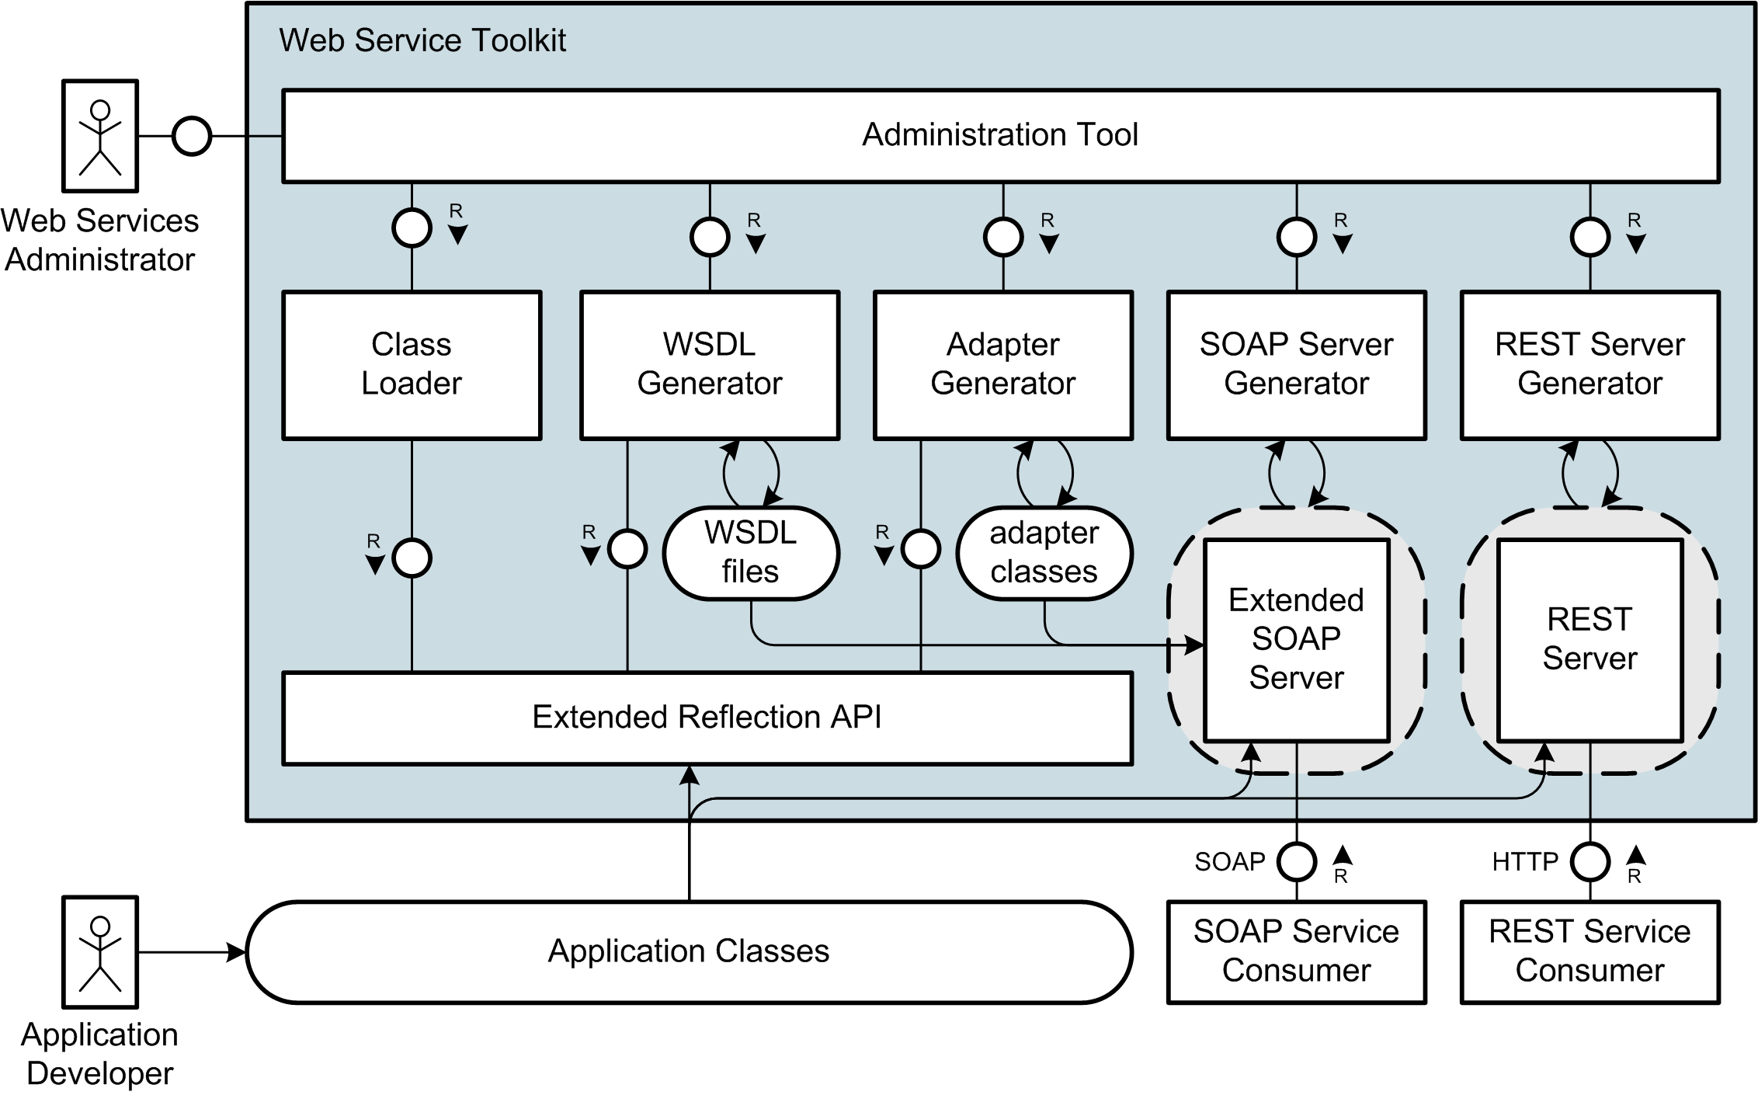

Slide 13
About the Project
  Base project developed by 6 HPI students since october 2005
    G. Gabrysiak, Ch. Hartmann, M. Perscheid, M. Sprengel
    Today here: Stefan Marr and Falko Menge
  Project presented at the FrOSCon 2006
  Open steps: contribute base to eZ Components
  Additional work
    Access Control in Service Oriented Architectures
    Implementation of Task-Role Base Access Control based on ServiceMix/Java and InstantSVC
Notes:
Think this slide goes here to show our experiences and qualifications on this topic
Anything to say about your work for TUK?

Slide 14
Running Example
  Application: Answering Machine
    Number of Calls
    List of Calls
  Example Web Service
    using SOAP Protocol
Notes:
Wichtige Punkt für solch einen Web Service
Gesichert durch Authentifizierung
Hier einfaches user/passwort
Je nach scenario vielleciht auch über client-zertifikate usw.
Notwendig einerseits für zugriffskontrolle
Andererseits fürs Abbrechnen der Zugriffe/Billing

Slide 15
Components of InstantSVC

Slide 16
Reflection API
  PHP 5.1 Extension
  Usage of PHP build-in Parser
  Structural Information at Runtime
    Classes
    Methods
    PHP Extensions
  But only very little Information about Types
    PHP is a dynamically typed Language

Slide 17
Annotations
  Additional Information in the Source Code
  Developed from Source Code Comments like:
    Pre and Post Conditions given in Comments
    Conceptual Properties
  Support in .NET and Java 5 already available
    But not in PHP
  Possible Usage Scenarios
    Marking or Configuring of Classes/Methods…
    Aspect-Oriented Programming
Notes:
Annotations sind mit der Zeit entstanden
Oft im Quelltext, in den Kommentaren angaben zu verschiedensten Dingen abgelegt
Pre- und PostConditions
Eigenschaften wie ist Webservice, liese sich zwar z.B. mit interfaces oder vererbung ebenfalls realisieren, als markierung
Ist teils jedoch nicht gewünscht, da mit konsequenzen verbunden

Slide 18
Extended Reflection API
  Extends the Reflection API of PHP 5.1
    Implemented in PHP
  Adding Annotation Mechanism
  Typing
    Parameters
    Return Values
    Attributes
  Types represented as Objects
  for easy Usage
    XMLSchema for Types

Slide 19
Annotations based on PHPDoc
  PHPDoc widely used in many Projects for Documentation
  Good Starting Point for Annotations
  Comparable Development in Java with XDoclet
  /**
  * @myAnnotation paramA paramB
  */
  class AnsweringMachineCall {
  /**
  * @return int
  */
  public function getCallId() { return intval($this->callId); }
  /**
  * @param string $value
  */
  public function setCallerName($value) { $this->callerName = $value; }
  }

Slide 20
The PHP Extension

Slide 21
Extended Reflection API
  Extended with Annotations and a type system
Notes:
Überleitung
- Aufbauend auf Reflection API

Slide 22
Web Services Description Language (WSDL)
  Platform independent language for describing interfaces
  Description contains
    Interface
    Method signatures
    Data types

Slide 23
WSDL Generator
  Generates WSDL from PHP Classes or Collections of Functions
  WSDL 1.1
    Supports RPC Encoded / Literal
    and Document Literal / Wrapped
    Conforms to the WS-I Basic Profile by 95%
  Uses DOM-API
  Tested with phpt Test Cases
    Reused from SOAP Extension
  Adapter Generator
    For document-wrapped Binding
    Classes for Un/wrapping of Arguments and Return Values
Notes:
Adapterklasse realisiert Kapselung
Unwrapping der Argumente
Wrapping der Rückgabewerte

Slide 24
Document/Literal
Adapter Generator
/**
* @param int $id
* @return Lecture
*/
public function getLecture($id) {…}
public function getLecture($param) {
return array("Lecture“
=> $this->target->getLecture($param->id));
}

Slide 25
Other Web Service Standards
  Basics are already implemented for PHP
    SOAP: PHP5 Extension, PEAR SOAP, NuSOAP
    UDDI: PEAR Package
    WSDL: Generator
  Over 20 additional WS-* Standards for
    Security
    Synchronisation
    Sessioning
  Standards add new Elements to SOAP Header

Slide 26
SOAP Intermediaries
  SOAP Standard describes Intermediaries
  Intermediaries are working on SOAP Message before reaching Ultimate Receiver
  Additional Features independent of final Web Service
  Implementation Pattern: Handler Chain

Slide 27
Handler Chain Mechanism

Slide 28
WS-Security for PHP5
  Security Concepts for Web Services:
    Confidentiality => SSL (SOAP via HTTPS)
    Authentication => WS-Security + Token Profiles
    Authorisation => Application
  WS-Security defines SOAP Header Element for
  security-related Data
  Different Profiles specify several Authentication Mechanisms
  First Profile implemented:
    Username Token Profile 1.0

Slide 29
WS-Security
Username Token Profile 1.0
<wsse:Security>
<wsse:UsernameToken>
<wsse:Username>Stefan</wsse:Username>
<wsse:Password Type="...#PasswordDigest">
weYI3nXd8LjMNVksCKFV8t3rgHh3Rw==
</wsse:Password>
<wsse:Nonce>WScqanjCEAC4mQoBE07sAQ==</wsse:Nonce>
<wsu:Created>2006-06-24T11:00:00Z</wsu:Created>
</wsse:UsernameToken>
</wsse:Security>

Slide 30
Username Token Profile (1/2)

Slide 31
Username Token Profile (2/2)

Slide 32
Username Token Profile 1.0 (Server)

Slide 33
Username Token Profile 1.0 (Client)

Slide 34
Representational State Transfer (REST)
  Alternative to SOAP Web Services
  Resource-oriented Approach
  HTTP-REST
    Just uses HTTP Methods
      GET, POST, PUT, DELETE
    Messages with Payload Semantic instead of RPC Semantic
  Implemented using a Remote Facade
    Mapping from URIs to PHP methods
    Custom De/Serialiser for PHP Objects
    REST Server Configuration generated from Code Annotations
  Security by TLS or DigestAuth (RFC2617)
Notes:
Roy Thomas Fielding
uniforme und minimale Interfaces
Bei SOAP definiert jede Anwendung/Web Service eingenes Interface
Vorteile Interoperabilität
Aussagen über allgemeines Verhalten der Dienste möglich, da uniforme Schnittstelle → uniforme Semantik
Verwendung des allgemeinen HTTP-URI Namensraumes für alle Resourcen

Slide 35
Administration Front-End
  Administration Front-End
    Automated Creation of Web Services from existing Applications
    Annotations identify Classes to be used
    Administration via Web Browser
      Classes and Methods selected by User
      Generates SOAP and REST Server Scripts
      Generates WSDL File and Adapter Classes
      SOAP Server with WS-Security

Slide 36
Administration Tool &
Policy Plug-In
  Administration Tool
    Automated Creation of Web Services from existing Applications
    Annotations identify Classes to be used
    Administration via Web Frontend
      Classes and Methods selected by User
      Generates SOAP and REST Server Scripts
      Generates WSDL File and Adapter Classes
      SOAP Server with WS-Security
  Policy Plug-In for WSDL-Generator
    Filters Methods to be hidden from Web Services
    Adds Comments to WSDL Ports from Source Code Documentation
    Enables Administrator to edit published Comments

Slide 37
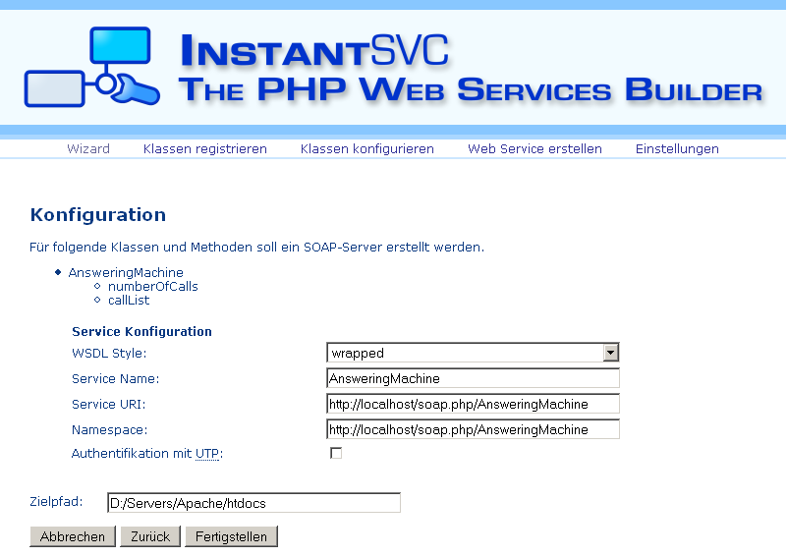
Administration Front-End

Slide 38
Components of InstantSVC

Slide 39
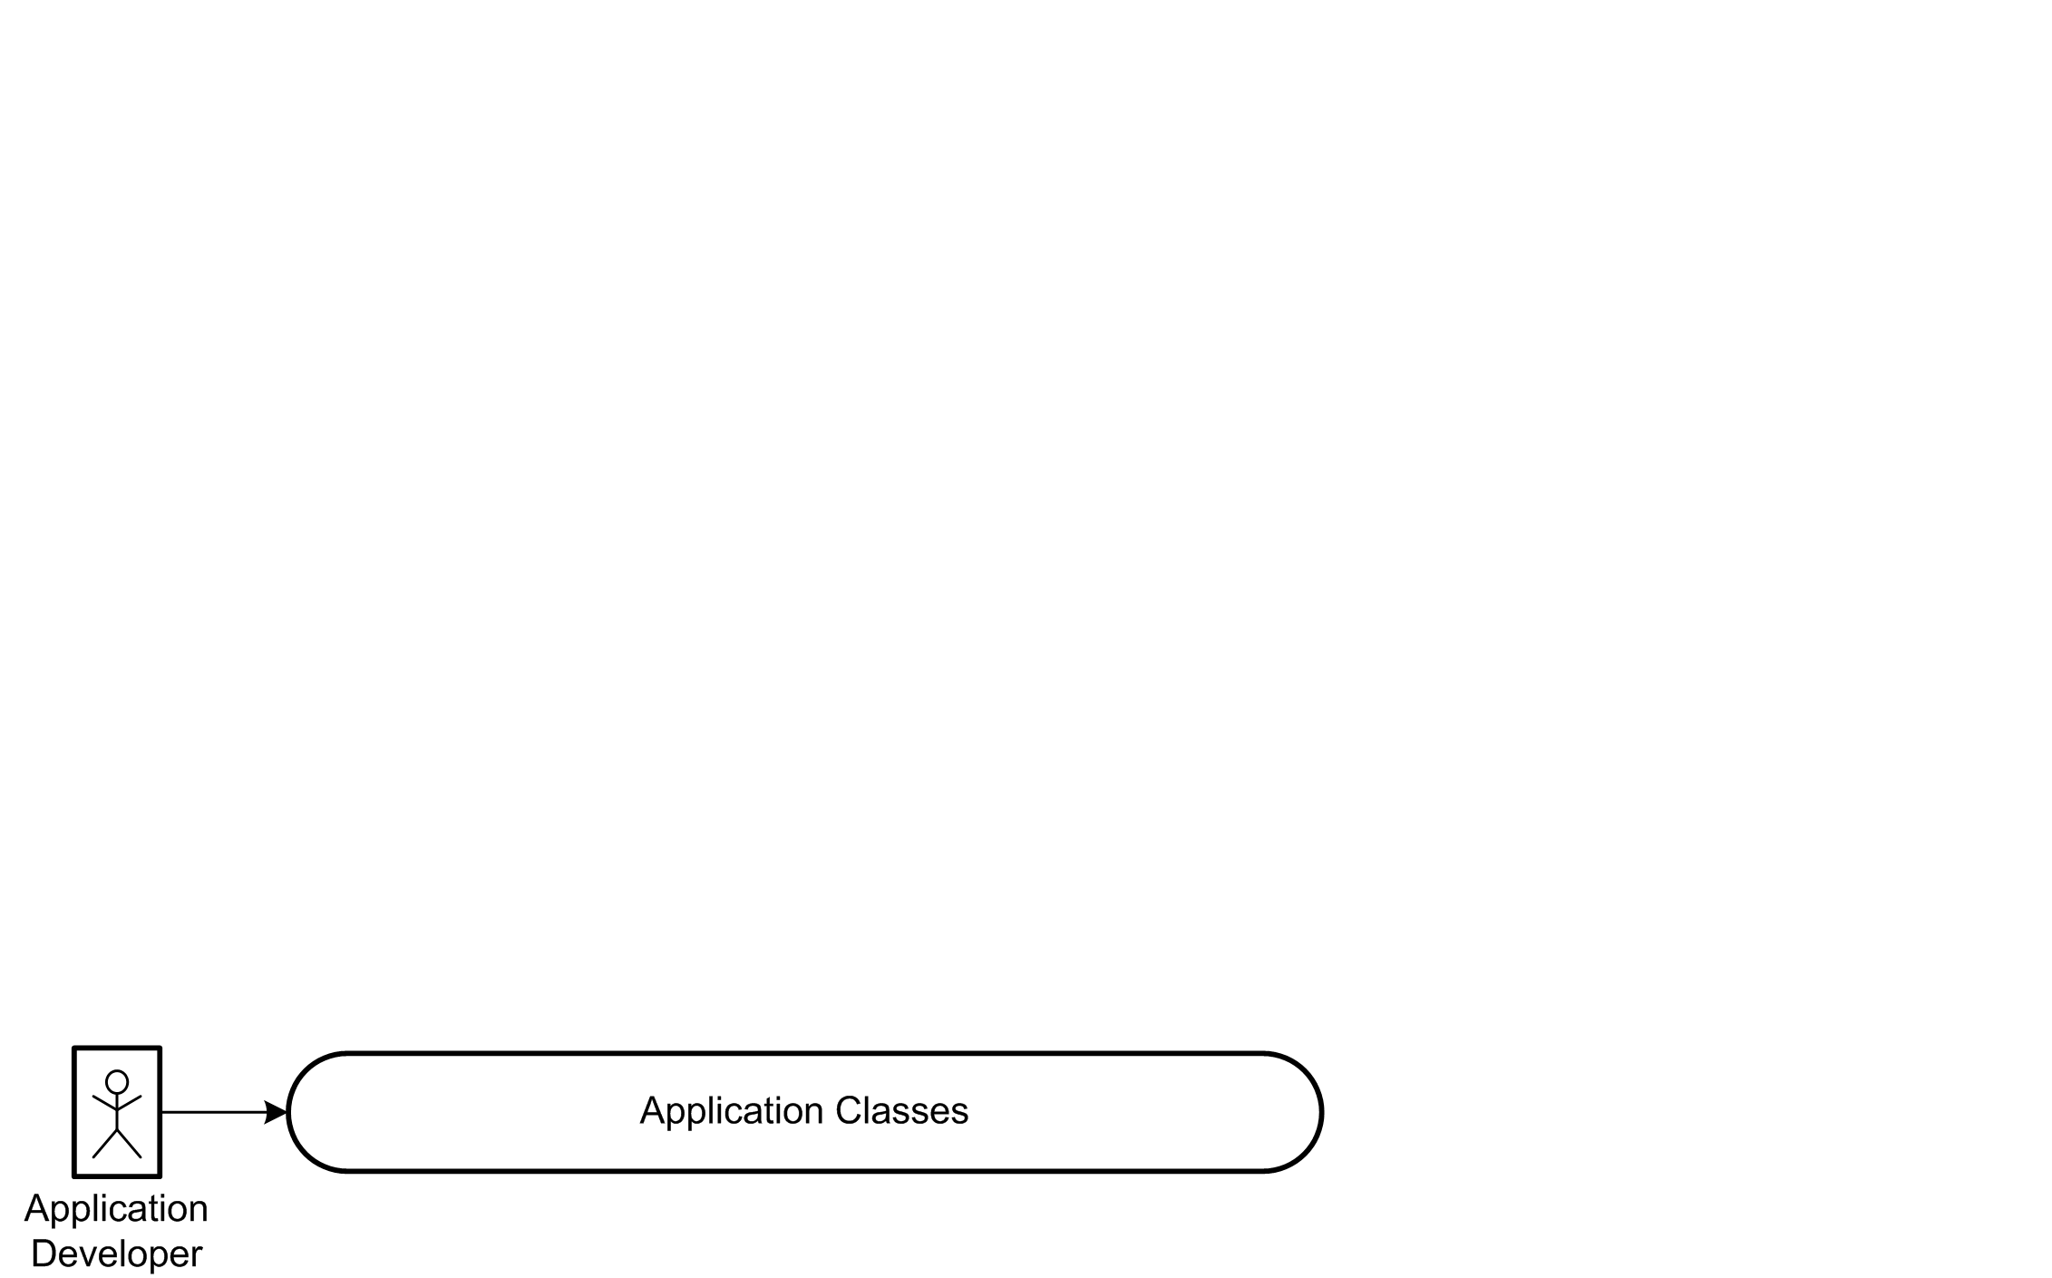
Interaction Overview

Slide 40
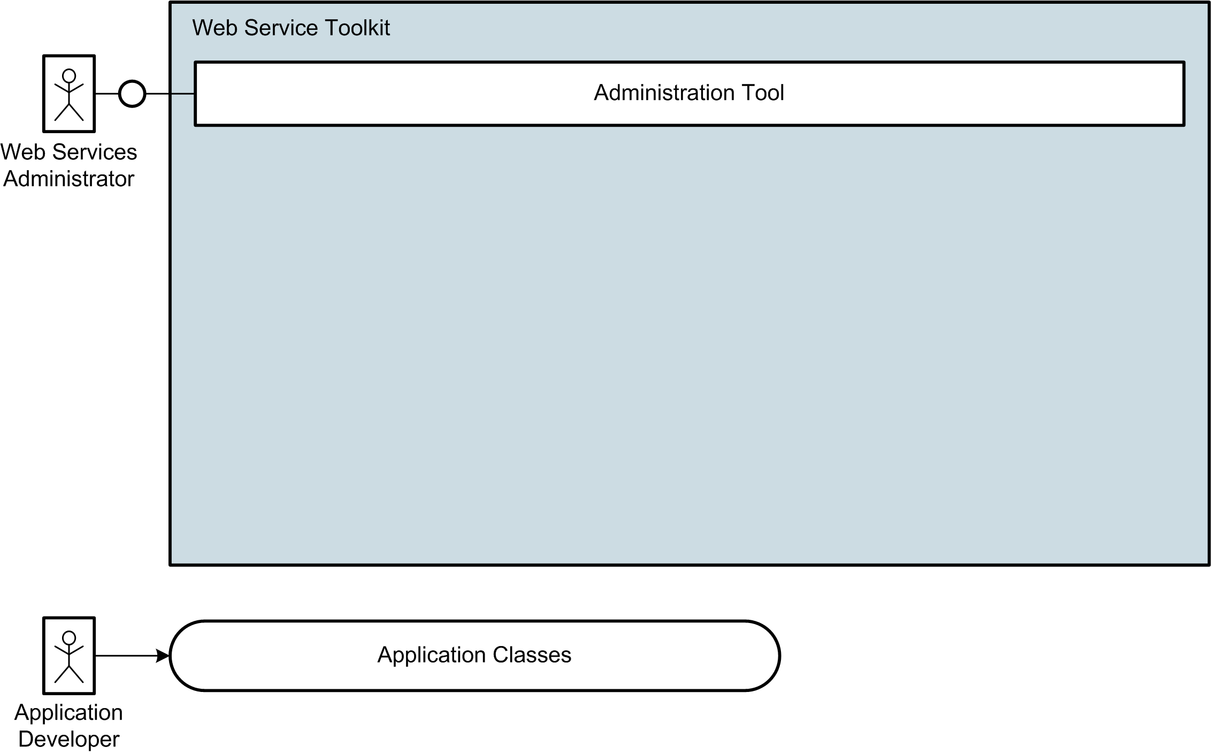
Interaction Overview

Slide 41
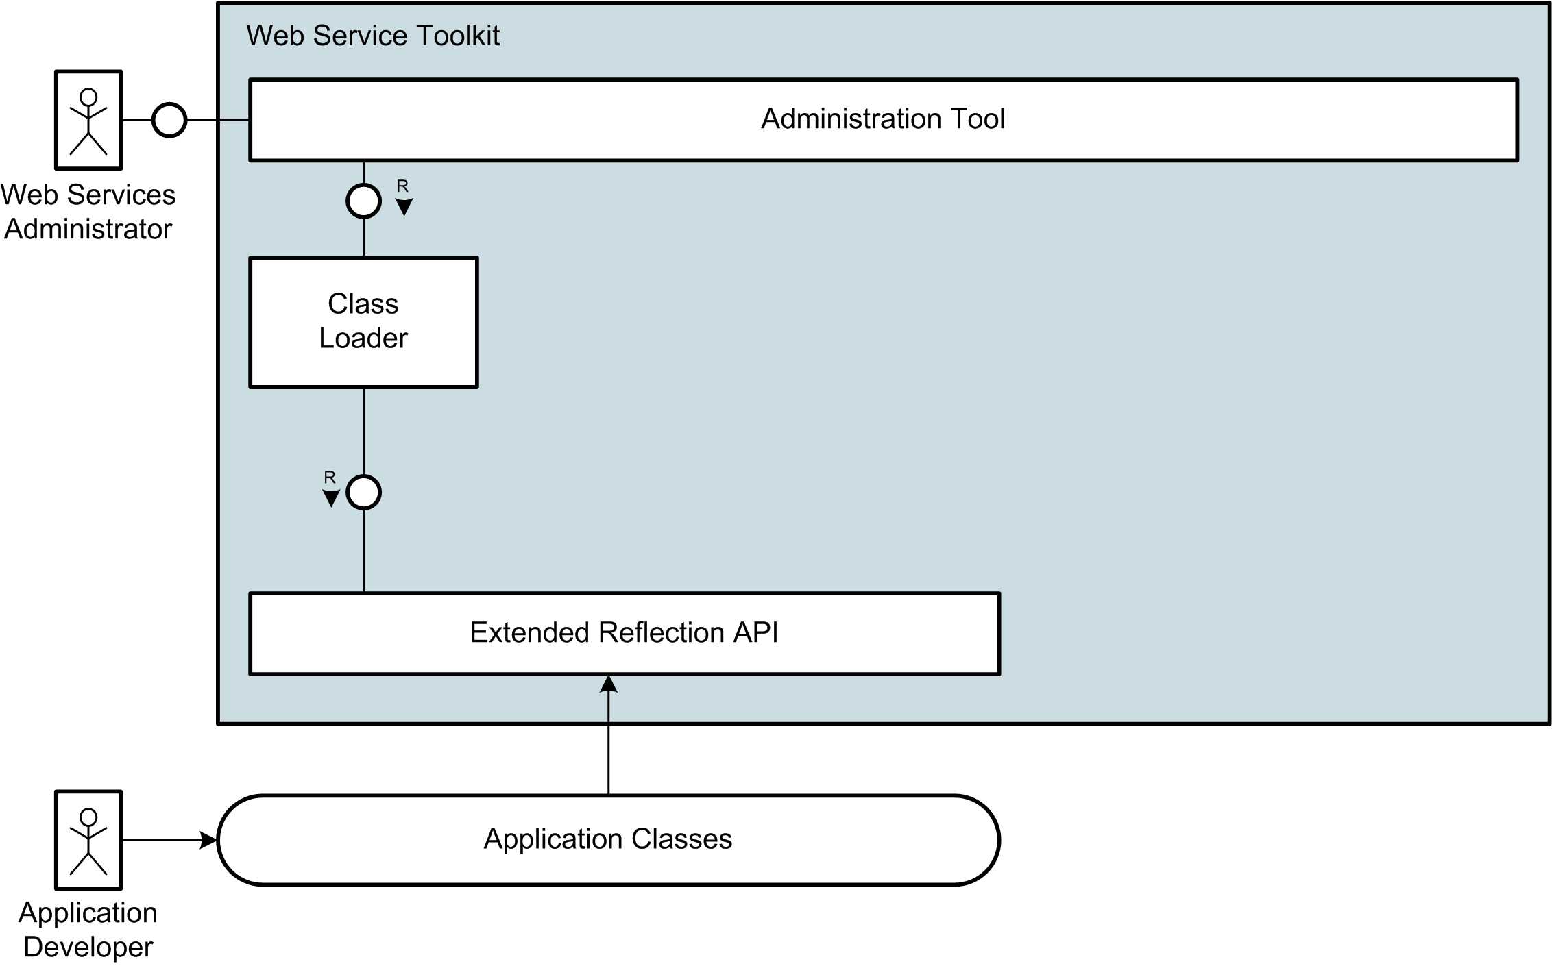
Interaction Overview

Slide 42
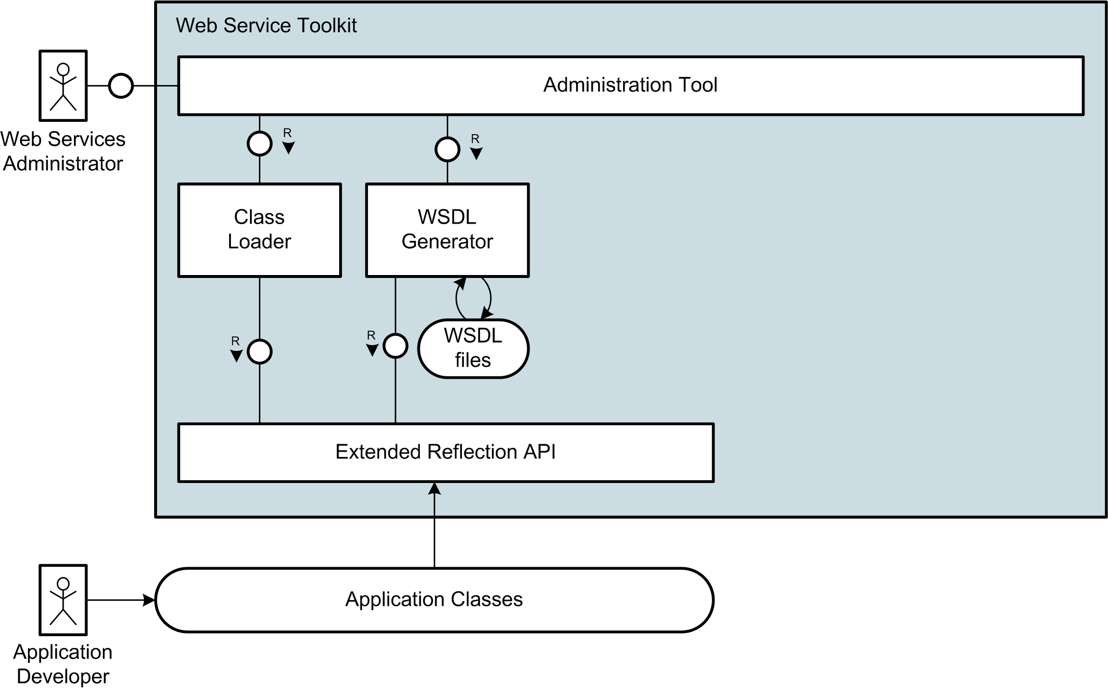
Interaction Overview

Slide 43
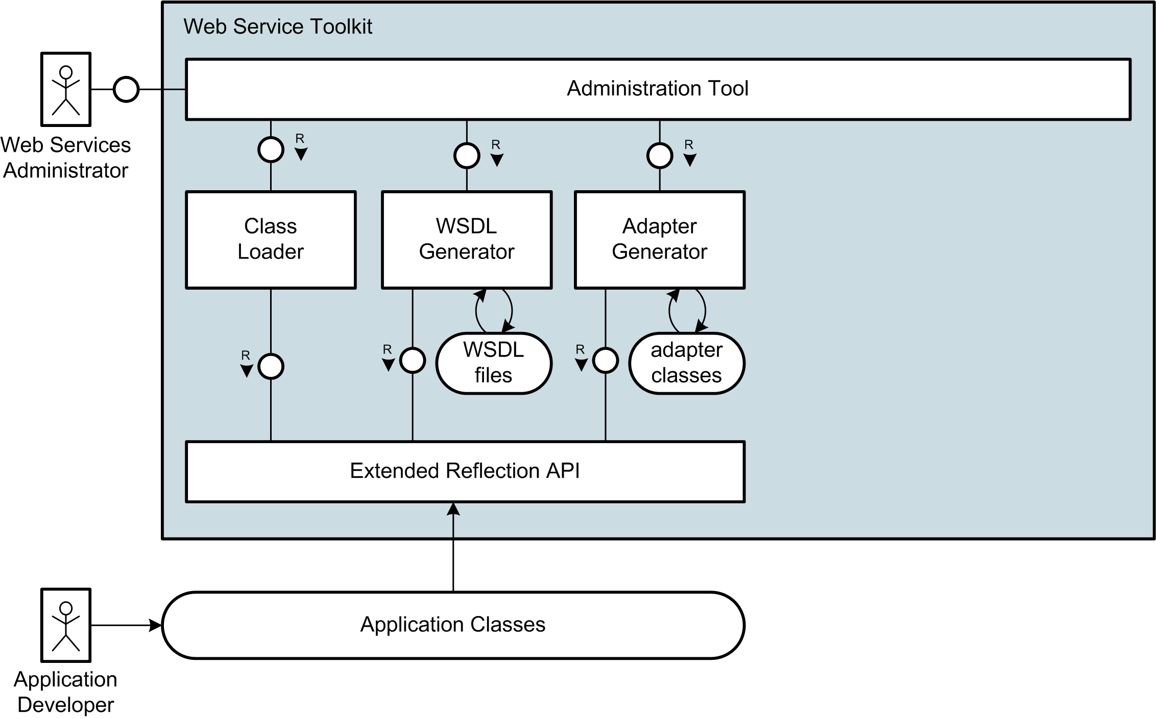
Interaction Overview

Slide 44
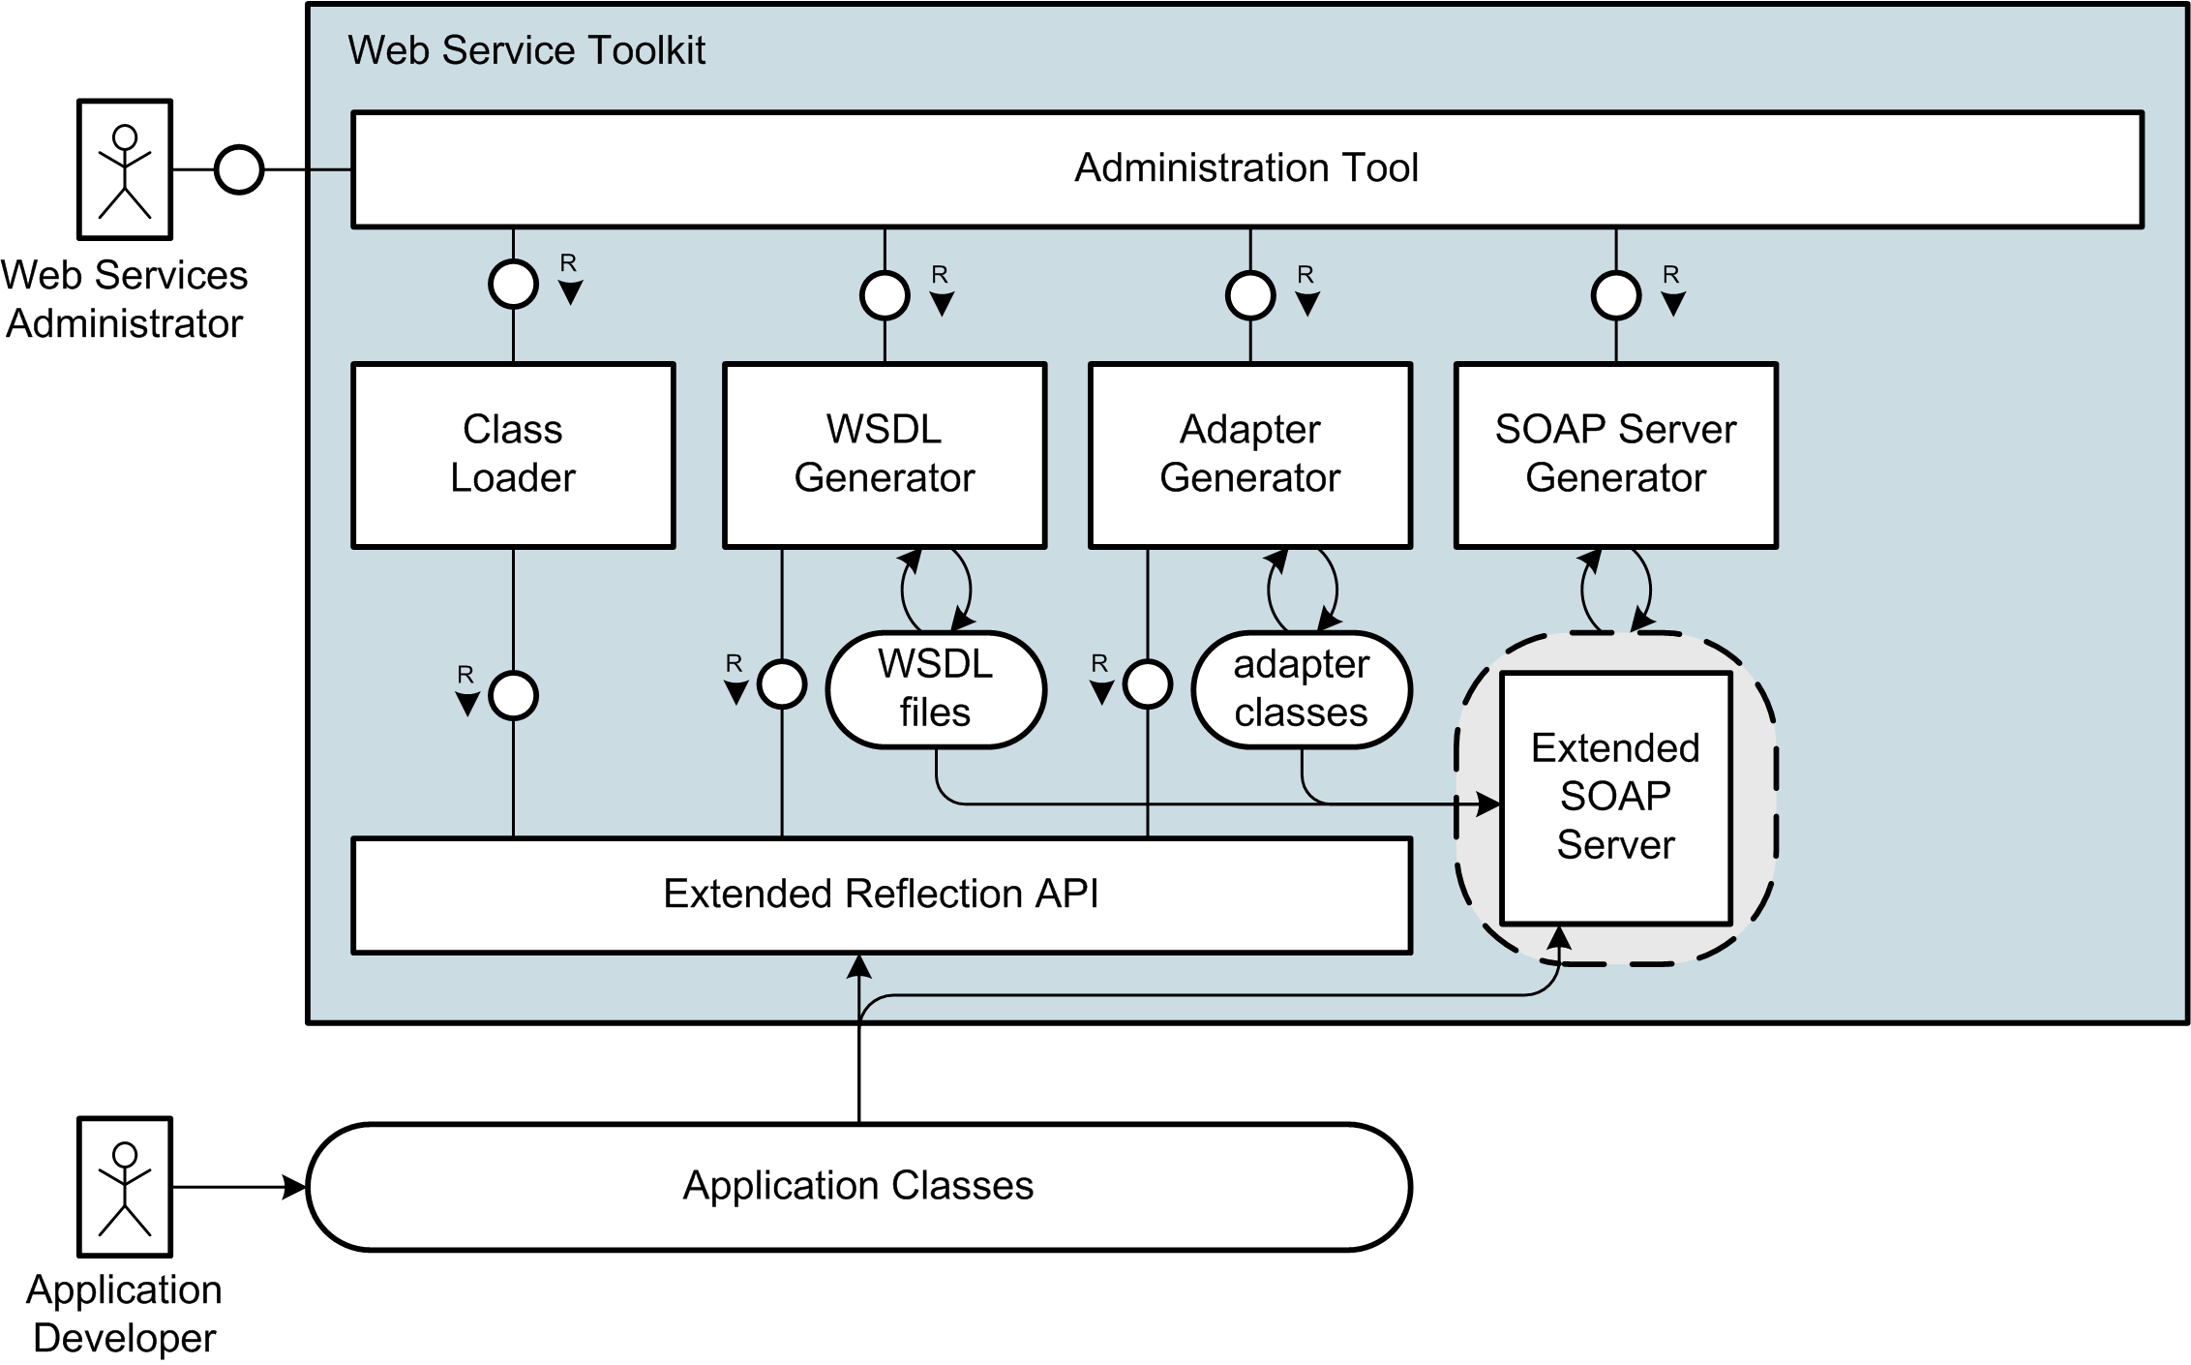
Interaction Overview

Slide 45
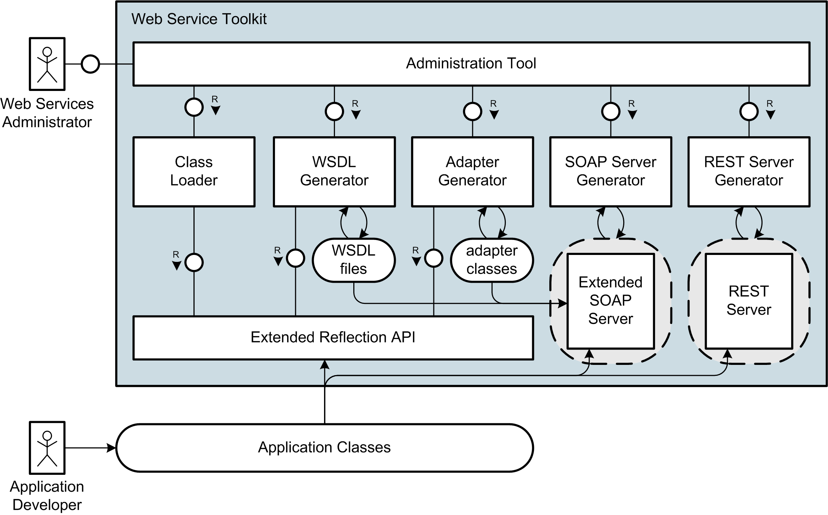
Interaction Overview

Slide 46
Interaction Overview

Slide 47
Live Demo

Slide 48
Example Application
  Application: Answering Machine
    Number of Calls
    List of Calls
  Example Web Service
    using SOAP Protocol
Notes:
Wichtige Punkt für solch einen Web Service
Gesichert durch Authentifizierung
Hier einfaches user/passwort
Je nach scenario vielleciht auch über client-zertifikate usw.
Notwendig einerseits für zugriffskontrolle
Andererseits fürs Abbrechnen der Zugriffe/Billing

Slide 49
Live Demo

Slide 50
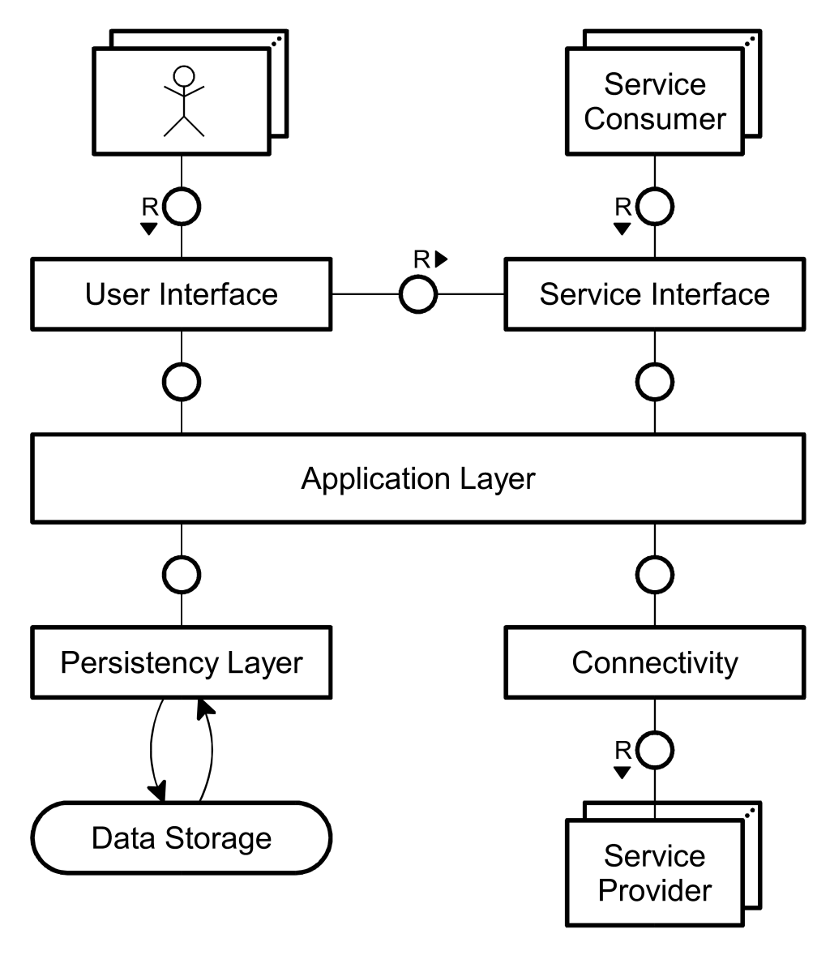
Proposed Application Architecture

Slide 51
Summary
  Extended Reflection API with Information about Types
  Annotations for PHP
  WSDL Generator conform to WS-I Basic Profile
  Document/Literal Adapter Generator
  Handler Chain Mechanism for SOAP Processing
  Implementation of WS-Security and Username Token Profile
  RESTful Web Services
  Administration Tool for convenient Creation und Management of SOAP and REST Services

Slide 52
Future of the Project
  Developed by 6 HPI Students since October 2005
    Stefan Marr
    Christoph Hartmann
    Michael Perscheid
    Martin Sprengel
    Gregor Gabrysiak
    Falko Menge
  Project presented at the FrOSCon 2006
  (Free and Open Source Software Conference)
  Next Step: Contribution to eZComponents

Slide 53
Further Information and Download at:
http://instantsvc.sourceforge.net

